Slide 1

18ECC205J – Analog and Digital Communication
Course Credit : 4
Theory : 9 Hours
1. Singh. R. P & Sapre. S. D, “Communication Systems: Analog & Digital,” 3rd edition, McGrawHill Education, Seventh Reprint, 2016. 2. Simon Haykin, “Communication Systems”, John Wiley & Sons, 4th Edition, 2008

Slide 2
Course Outline
ADC
1. Analog Modulation
2. Radio Transmitters and Receivers
3. Digital Modulation System and Baseband Detection
4. Passband Data Transmission
5. Spread Spectrum Techniques and Information theory Concepts

Slide 3
Unit 4 – Pass band Data Transmission
Overview of ASK, FSK, PSK
Generation, Signal Space Diagram and detection of FSK
Probability of Error for FSK
Generation, Detection, Signal Space Diagram of PSK
Probability of Error for PSK
Generation, signal space diagram and detection of QPSK
Probability of Error for QPSK
Generation, signal space diagram and detection of π/4 QPSK
Generation, signal space diagram and detection of QAM

Slide 4
Digital Modulation – Pass band Data Transmission
Digital Modulation provides more information capacity, high data security, quicker system availability with great quality communication.
Hence, digital modulation techniques have a greater demand, for their capacity to convey larger amounts of data than analog modulation techniques.
Types of digital modulation techniques
ASK – Amplitude Shift Keying
The amplitude of the resultant output depends upon the input data whether it should be a zero level or a variation of positive and negative, depending upon the carrier frequency.
FSK – Frequency Shift Keying
The frequency of the output signal will be either high or low, depending upon the input data applied.
PSK – Phase Shift Keying
The phase of the output signal gets shifted depending upon the input. These are mainly of two types, namely Binary Phase Shift Keying BPSK and Quadrature Phase Shift Keying QPSK, according to the number of phase shifts.
Differential Phase Shift Keying DPSK
The output signal changes the phase according to the previous value.
M-ary Encoding
M-ary Encoding techniques are the methods where more than two bits are made to transmit simultaneously on a single signal. This helps in the reduction of bandwidth.
The types of M-ary techniques are −
M-ary ASK
M-ary FSK
M-ary PSK

Slide 5
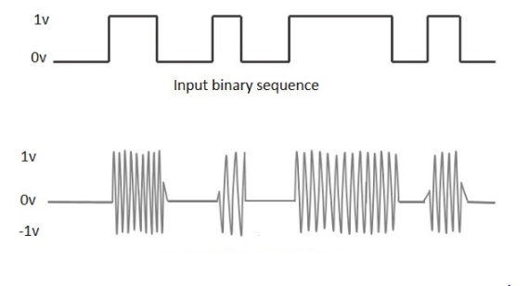
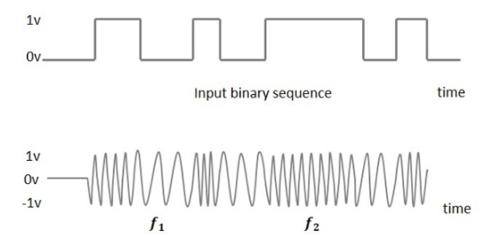
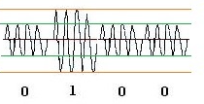
ASK, FSK
Frequency Shift Keying FSK is the digital modulation technique in which the frequency of the carrier signal varies according to the digital signal changes.
The output of a FSK modulated wave is high in frequency for a binary High input and is low in frequency for a binary Low input. The binary 1s and 0s are called Mark and Space frequencies.
The following image is the diagrammatic representation of FSK modulated waveform along with its input.
Amplitude Shift Keying ASK is a type of Amplitude Modulation which represents the binary data in the form of variations in the amplitude of a signal.
Any modulated signal has a high frequency carrier. The binary signal when ASK modulated, gives a zero value for Low input while it gives the carrier output for High input.
The following figure represents ASK modulated waveform along with its input.

Slide 6
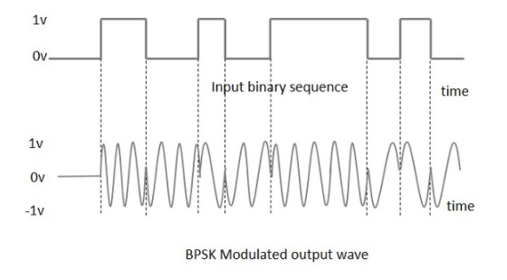
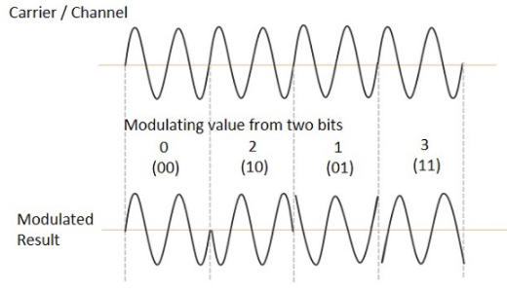
PSK, QPSK
Phase Shift Keying PSK is the digital modulation technique in which the phase of the carrier signal is changed by varying the sine and cosine inputs at a particular time.
PSK technique is widely used for wireless LANs, bio-metric, contactless operations, along with RFID and Bluetooth communications.
PSK is of two types, depending upon the phases the signal gets shifted. They are −
Binary Phase Shift Keying BPSK
This is also called as 2-phase PSK or Phase Reversal Keying. In this technique, the sine wave carrier takes two phase reversals such as 0° and 180°.
BPSK is basically a Double Side Band Suppressed Carrier DSBSC modulation scheme, for message being the digital information.
Quadrature Phase Shift Keying QPSK
This is the phase shift keying technique, in which the sine wave carrier takes four phase reversals such as 0°, 90°, 180°, and 270°.
QPSK sends two bits of digital information at a time, called as bigits.
Instead of the conversion of digital bits into a series of digital stream, it converts them into bit pairs. This decreases the data bit rate to half, which allows space for the other users.
If this kind of techniques are further extended, PSK can be done by eight or sixteen values also, depending upon the requirement.
.

Slide 7
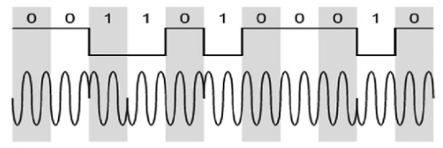
DPSK
In Differential Phase Shift Keying DPSK the phase of the modulated signal is shifted relative to the previous signal element. No reference signal is considered here. The signal phase follows the high or low state of the previous element. This DPSK technique doesn’t need a reference oscillator.
The following figure represents the model waveform of DPSK.
It is seen from the above figure that, if the data bit is Low i.e., 0, then the phase of the signal is not reversed, but continued as it was. If the data is a High i.e., 1, then the phase of the signal is reversed, as with NRZI, invert on 1.
If we observe the above waveform, we can say that the High state represents an M in the modulating signal and the Low state represents a W in the modulating signal.

Slide 8
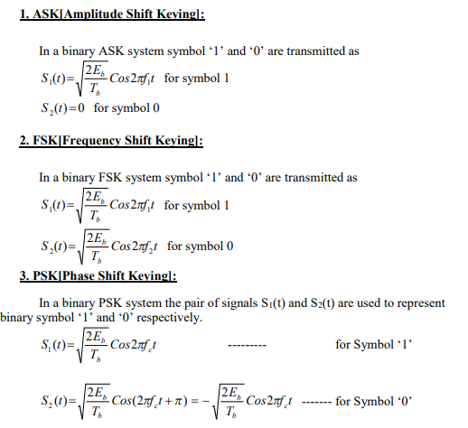
ASK,PSK,FSK

Slide 9
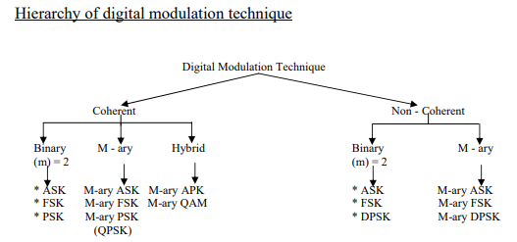

Slide 10
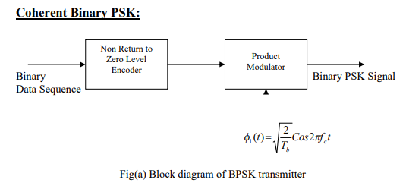
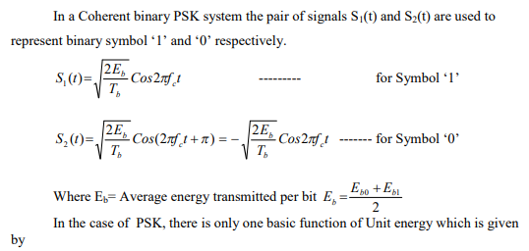
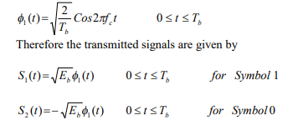
Binary PSK Generation

Slide 11
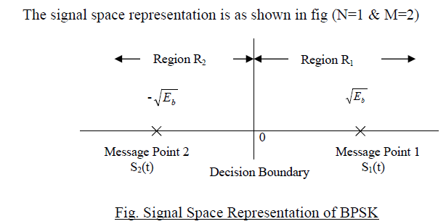
BPSK Signal Space Diagram

Slide 12
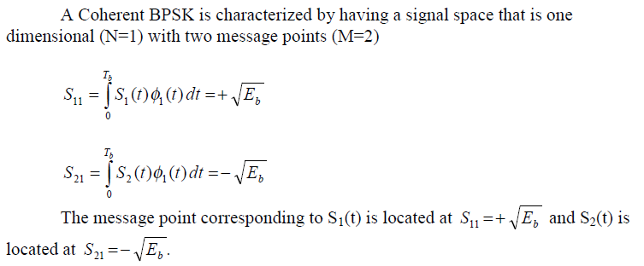
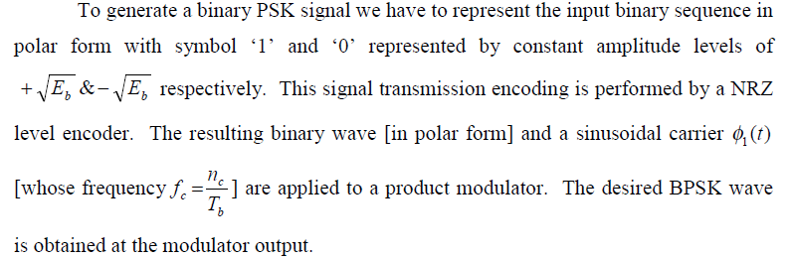
BPSK Signal Space Diagram

Slide 13
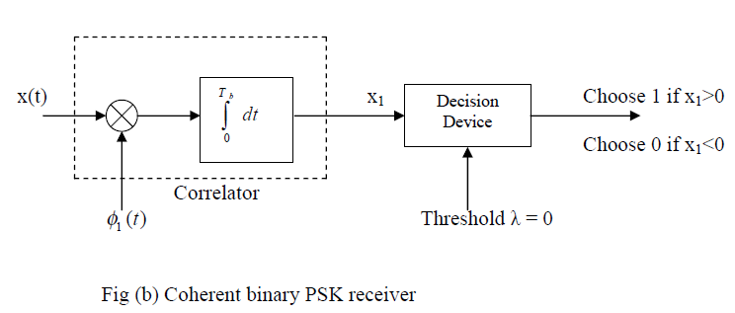
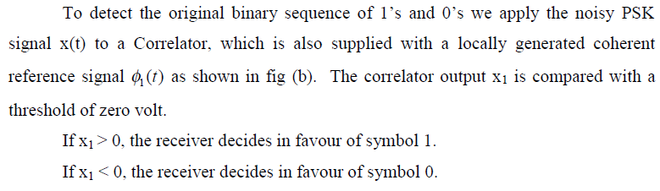
BPSK Detector

Slide 14
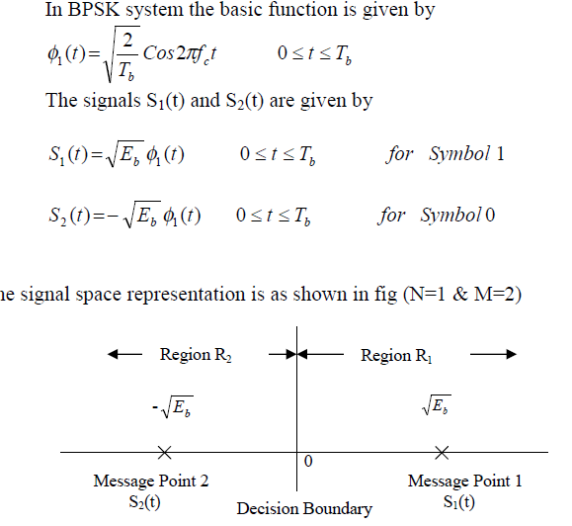
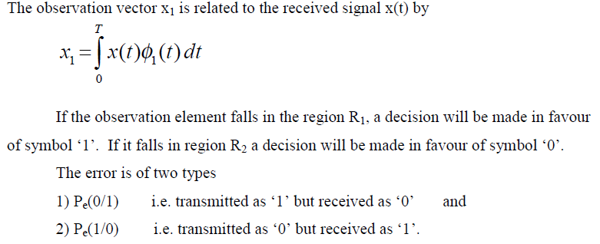
BPSK – Probability of Error

Slide 15
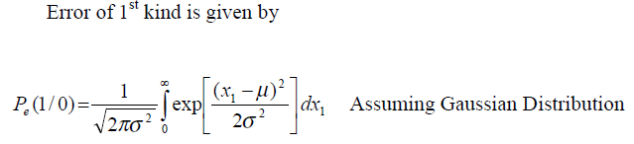
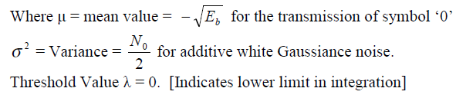
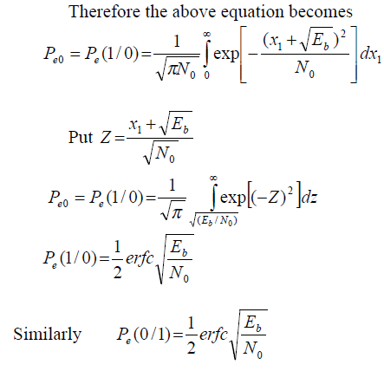
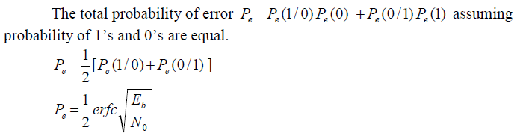
BPSK – Probability of Error

Slide 16
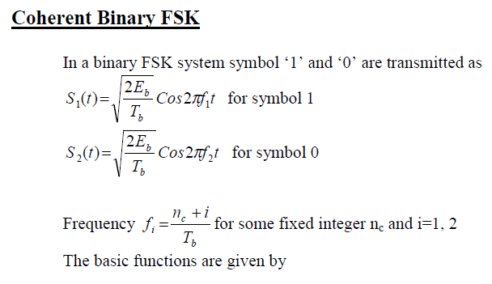
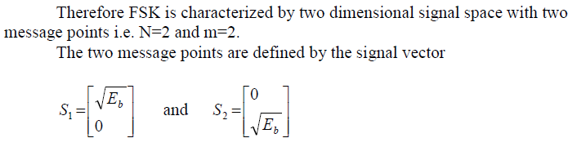
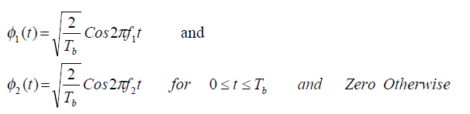
BFSK

Slide 17
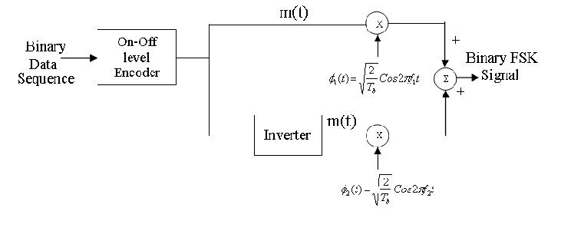
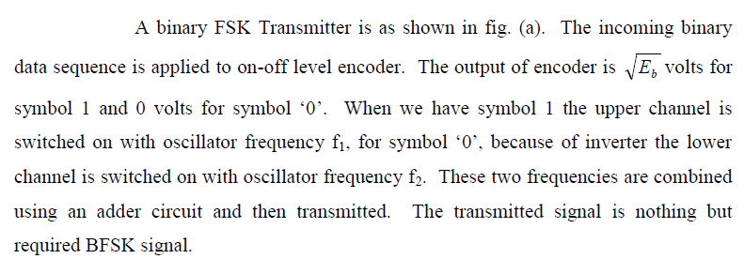
BFSK - Generation

Slide 18
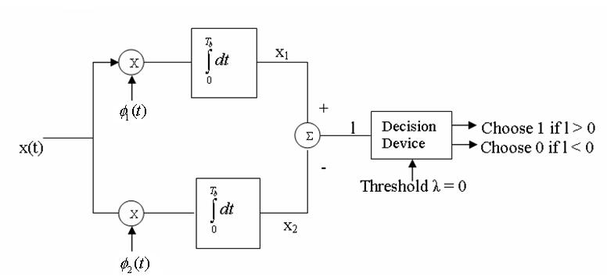
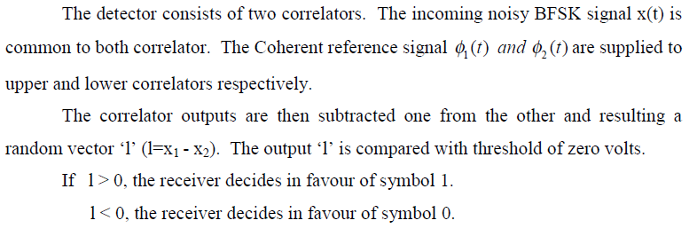
BFSK Detector

Slide 19
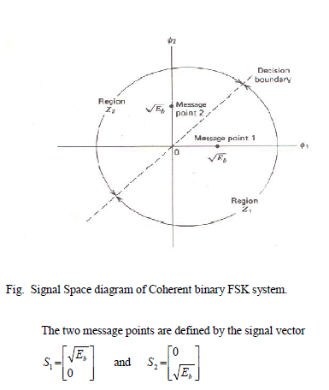
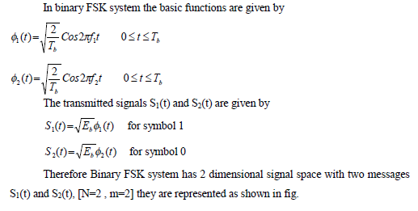
BFSK – Signal Space Diagram

Slide 20
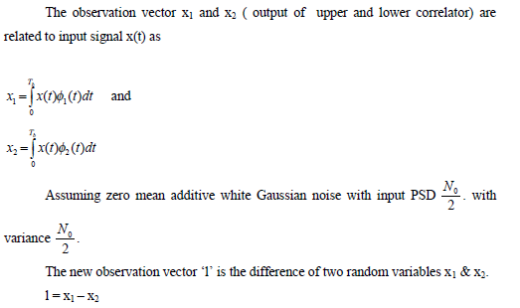
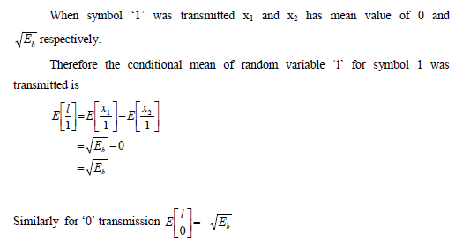
BFSK – Probability of Error

Slide 21
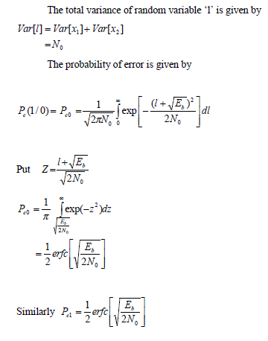
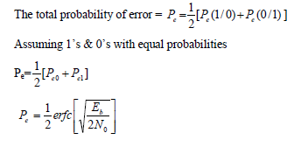
BFSK – Probability of Error

Slide 22
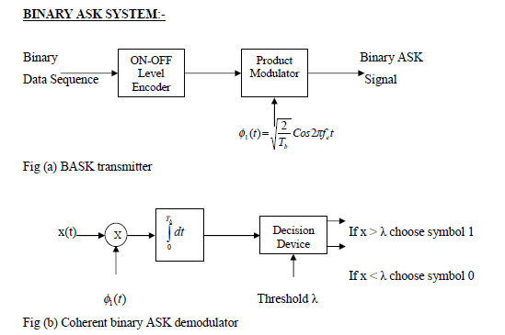
Binary Amplitude Shift Keying - BASK

Slide 23
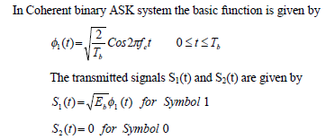
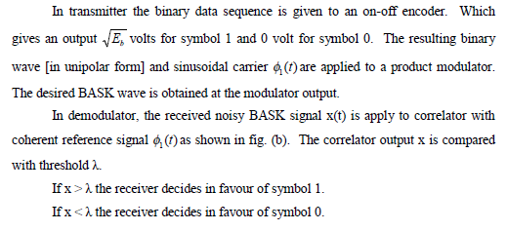
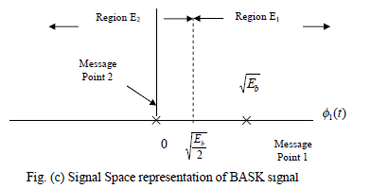
BASK – Signal Space Diagram
The BASK system has one dimensional signal space with two messages (N=1, M=2)

Slide 24
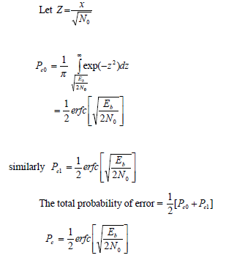
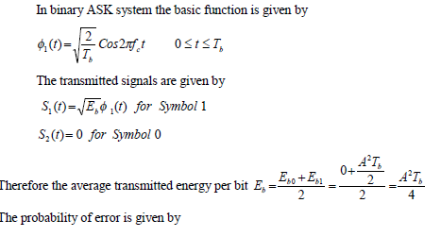
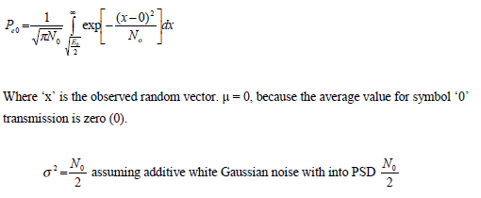
BASK – Probability of Error

Slide 25
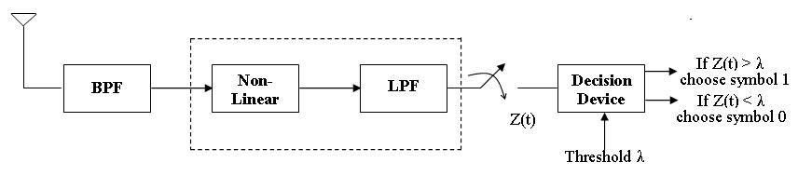

Non Coherent Detection
Non-coherent detection as used in analog communication does not require carrier for reconstruction.
The simplest form of incoherent detector is the envelope detector as shown below. The output of envelope detector is the baseband signal.
Once the baseband signal is recovered, its samples are taken at regular intervals and compared with threshold.

Slide 26
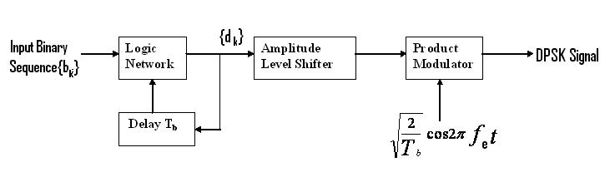
DPSK Generation
DPSK system may be viewed as the non coherent version of the PSK.
It eliminates the need for coherent reference signal at the receiver by combining two basic operations at the transmitter
(1) Differential encoding of the input binary wave and
(2) Phase shift keying
Hence the name differential phase shift keying [DPSK]. To send symbol ‘0’ we
phase advance the current signal waveform by 1800 and to send symbol 1 we leave the
phase of the current signal waveform unchanged.

Slide 27
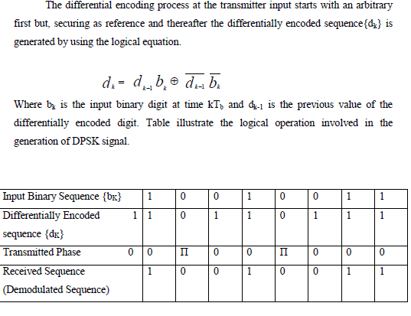
DPSK Generation

Slide 28
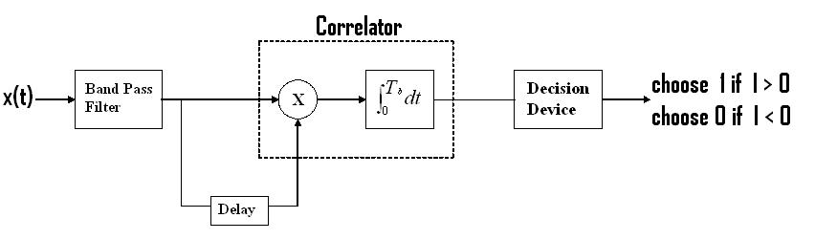
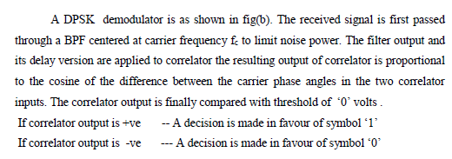
DPSK Detection

Slide 29
Review Questions
Q1.
Q2.

Slide 30
Answers
1.
2

